Slide 1
ITEC 2150
Intermediate Programming

Slide 2
Instructor
Mr. Rick Price
Office: C-1321
Phone: 678-231-7282
About me
US Navy
Flew A-6 Intruders
Retired as a CDR
Worked in the software industry for 17 years
C++ programmer to Director of Development
Continuing to work as a consultant
GGC
Married have two daughters and two sons-in-law
Enjoy waterskiing, fishing and boating

Slide 3


Slide 4
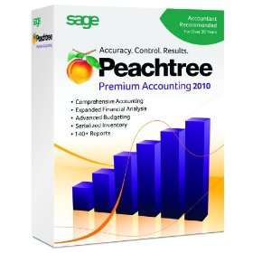
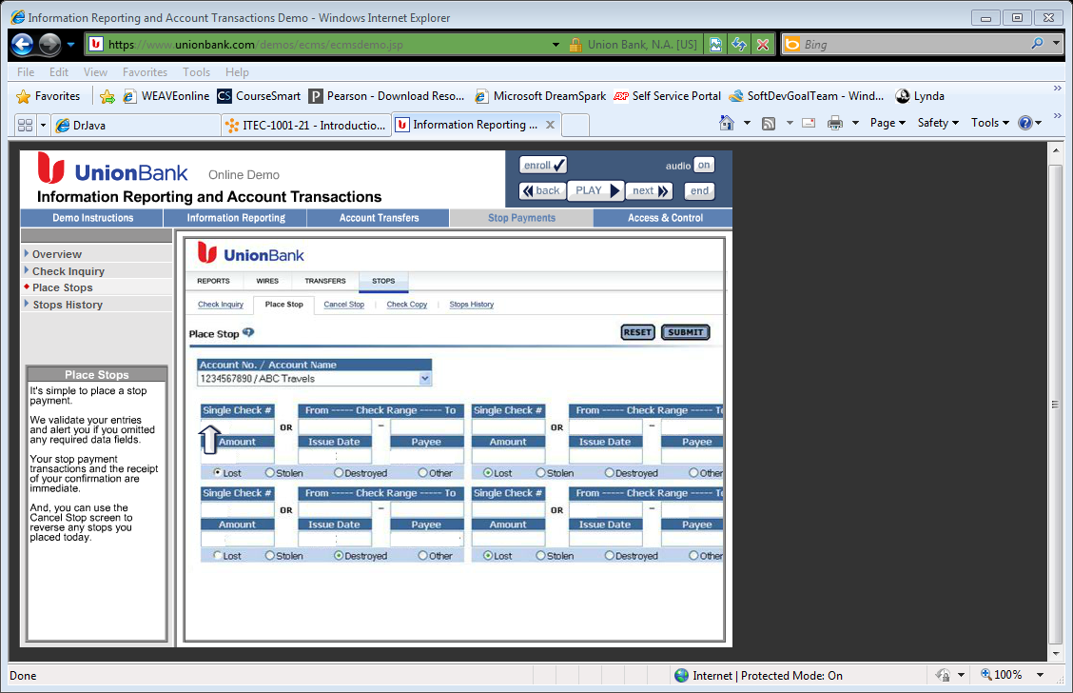
Software Development

Slide 5
Contact Information
If you text (678-231-7282)
Phone calls – 678-231-7282
Email
I will only email GGC addresses
Please include your name and course when you contact me

Slide 6
About you
Find a classmate you don’t already know
Find out:
Name
Major
Class
Something they like to do besides school
Report finding to class

Slide 7
Syllabus

Slide 8
How to Succeed
Be prepared for each class.
Read assignment before coming to class
Get to class on-time
Stay for whole class
Do in-class activities
Do your homework!
Ask questions
If needed, get help.
Come see me
Tutoring assistance in Academic Enhancement Center
ITEC Tutoring
http://wiki.ggc.edu/wiki/ITEC_Tutoring
This course is cumulative. You will use material from today when you write your last program.

Slide 9
Requirements/Tools
Introduction to Java Programming – Liang (10th edition)
My Programming Lab
Java 10 recommended, Java 8 or higher – Required for JavaFX
Your choice of IDE
Eclipse – Strongly recommended
Net Beans
Dr. Java – Strongly not recommended
Others
Coding Bat
Lynda.com

Slide 10
Grades
10 point grading scale
90 – 100 = A
80 – 90 = B
70 – 80 = C
60 – 70 = D
Below 60 = F
Grades are calculated for mid-term and final
I do not curve
I do not “give points”
Your grade will be what you earn
Code that doesn’t compile will result in a 50 at most

Slide 11
Graded Events
 | Number | Percentage
Homework | 3 | 15%
In-Class Activities | 7 | 15%
Project | 1 | 10%
Tests | 2 | 20% each
Final | 1 | 20%
Participation is graded for every class and is part of your In-Class grade

Slide 12
Late and Resubmitted Work
Late
10% deduction per day late, after 3 days, 50% deduction
After 5 days dropbox closes and no submission is accepted
Resubmitted Work
10 point penalty for re-submission
Only one resubmission will be accepted
Once reviewed in class, no submissions accepted
No late work can be submitted here

Slide 13
Academic Enhancement Center
http://wiki.ggc.edu/wiki/ITEC_Tutoring

Slide 14
Cell phones and computer use
Please silence your cell phone
If you have extenuating circumstances where you need to use them, please let me know
Computer use
Please restrict it to course material
Facebook will never be considered course material for this course

Slide 15
Communication
Yes, I want to have open communication
Text – 678-231-7282
Phone – 678-231-7282
Email – rprice@ggc.edu
Please check your GGC email daily
I will not communicate with you using a different email
Please include your name and course number
Please do not use D2L or My Programming Lab emails

Slide 16
Academic integrity
Who gains when you violate this policy?
You don’t
Other than on the grade
I will recognize “unusually good” code
It usually takes me less than 5 minutes to find code copied from the internet
A zero will be awarded
An academic integrity violation will be submitted
You will not learn the material
Much better to talk to me and learn the material

Slide 17
Course changes
I reserve the right to change the syllabus at any time to improve the deliver of this material

Slide 18
Chapter 1
Introduction to Computers, Programs, and Java

Slide 19
Programs
Computer programs, known as software, are instructions to the computer.
You tell a computer what to do through programs. Without programs, a computer is an empty machine. Computers do not understand human languages, so you need to use computer languages to communicate with them.
Programs are written using programming languages.

Slide 20
Interpreting/Compiling Source Code
A program written in a high-level language is called a source program or source code. Because a computer cannot understand a source program, a source program must be translated into machine code for execution. The translation can be done using another programming tool called an interpreter or a compiler.

Slide 21
Anatomy of a Java Program
Class name
Main method
Statements
Statement terminator
Reserved words
Comments
Blocks

Slide 22
Chapter 2
Elementary Programming

Slide 23
Identifiers
An identifier is a sequence of characters that consist of letters, digits, underscores (_), and dollar signs ($).
An identifier must start with a letter, an underscore (_), or a dollar sign ($). It cannot start with a digit.
An identifier cannot be a reserved word. (See Appendix A, “Java Keywords,” for a list of reserved words).
An identifier cannot be true, false, or null.
An identifier can be of any length.

Slide 24
Primitive Types
Type | Description | Size
int | The integer type, with range -2,147,483,648 . . . 2,147,483,647 | 4 bytes
byte | The type describing a single byte, with range -128 . . . 127 | 1 byte
short | The short integer type, with range -32768 . . . 32767 | 2 bytes
long | The long integer type, with range -9,223,372,036,854,775,808 . . . 9,223,372,036,854,775,807 | 8 bytes
double | The double-precision floating-point type, with a range of about ±10³⁰⁸ and about 15 significant decimal digits | 8 bytes
float | The single-precision floating-point type, with a range of about ±10³⁸ and about 7 significant decimal digits | 4 bytes
char | The character type, representing code units in the Unicode encoding scheme | 2 bytes
boolean | The type with the two truth values false and true | 1 bit

Slide 25
Declaring Variables
int x; // Declare x to be an
// integer variable;
double radius; // Declare radius to
// be a double variable;
char a; // Declare a to be a
// character variable;

Slide 26
Constants: final
A final variable is a constant
Once its value has been set, it cannot be changed
Named constants make programs easier to read and maintain
Convention: Use all-uppercase names for constants
final double QUARTER_VALUE = 0.25; final double DIME_VALUE = 0.1; final double NICKEL_VALUE = 0.05; final double PENNY_VALUE = 0.01; payment = dollars + quarters * QUARTER_VALUE + dimes * DIME_VALUE + nickels * NICKEL_VALUE + pennies * PENNY_VALUE;

Slide 27
Arithmetic Operators
Four basic operators:
addition: +
subtraction: -
multiplication: *
division: /
Parentheses control the order of subexpression computation:
(a + b) / 2
Multiplication and division bind more strongly than addition and subtraction:
(a + b) / 2

Slide 28
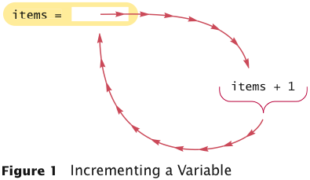
Increment and Decrement
items++ is the same as items = items + 1
items-- subtracts 1 from items

Slide 29
Integer Division
/ is the division operator
If both arguments are integers, the result is an integer. The remainder is discarded
7.0 / 4 yields 1.75 7 / 4 yields 1
Get the remainder with % (pronounced “modulo”) 7 % 4 is 3

Slide 30
Remainder Operator
Remainder is very useful in programming. For example, an even number % 2 is always 0 and an odd number % 2 is always 1. So you can use this property to determine whether a number is even or odd. Suppose today is Saturday and you and your friends are going to meet in 10 days. What day is in 10 days? You can find that day is Tuesday using the following expression:

Slide 31

Powers and Roots
Math class: contains methods sqrt and pow to compute square roots and powers
To compute x^{n}, you write Math.pow(x, n)
However, to compute x² it is significantly more efficient simply to compute x * x
To take the square root of a number, use Math.sqrt; for example, Math.sqrt(x)
In Java, can be represented as (-b + Math.sqrt(b * b - 4 * a * c)) / (2 * a)

Slide 32
Mathematical Methods
Function | Returns
Math.sqrt(x) | square root
Math.pow(x, y) | power x^{y}
Math.exp(x) | e^{x}
Math.log(x) | natural log
Math.sin(x), Math.cos(x), Math.tan(x) | sine, cosine, tangent (x in radians)
Math.round(x) | closest integer to x
Math.min(x, y), Math.max(x, y) | minimum, maximum

Slide 33
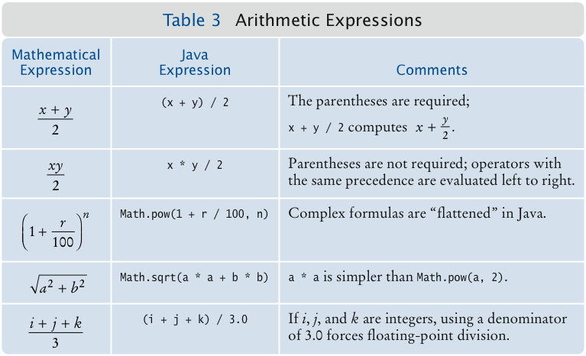
Arithmetic Expressions

Slide 34
Cast and Round
Cast converts a value to a different type:
double balance = total + tax;
int dollars = (int) balance;
Math.round converts a floating-point number to nearest integer:
long rounded = Math.round(balance);
// if balance is 13.75, then rounded is set to 14

Slide 35
Binary Numbers
Converting from binary to decimal
Computer the powers of two that correspond to ones in the binary number
1101
8+4+1 = 13

Slide 36
Binary Numbers
Converting decimal to binary
Divide by 2 until the number is 0
The remainders in reverse order is the binary number
100/2 = 50 remainder 0
50/2 = 25 remainder 0
25/2 = 12 remainder 1
12/2 = 6 remainder 0
6/2 = 3 remainder 0
3/2 = 1 remainder 1
½ = 0 remainder 1
Binary number 1100100

Slide 37
Binary Numbers
Converting decimal fraction to binary
Multiply fraction by 2
If the number is > 0
Subtract 1 and repeat
Stop when the number equals 0 (repeating numbers stop at precision required)
Assemble the binary number from the carry
.35
.35 * 2 = 0.7
.7 *2 = 1.4
.4*2 = 0.8
.8*2 = 1.6
.6*2 = 1.2
.2*2 = 0.4
.35 = .010110

Slide 38
Negative Numbers
Most significant bit is a sign bit
If bit is a 1, number is negative
If bit is a 0, number is positive
2’s Complement
First take the 1’s complement of the binary number
8 = 00001000
1’s complement
11110111
2’s complement – add 1 to 1’s complement
11111000 = -8
Converting back
Subtract 1
11111000 – 1 = 11110111
Take 1’s complement 00001000
Convert to decimal
http://academic.evergreen.edu/projects/biophysics/technotes/program/2s_comp.htm

Slide 39
Binary Number Conversion
11111000
00010000
00001000
00000001
11111110
11111111
Notes:
128+64+32+16 + 8 = 248
16
1
254
255

Slide 40
Decimal Number Conversion
128
96
202
Notes:
128 – 0, 64 – 0, 32 – 0, 16 – 0, 8 – 0, 4 – 0, 2-0, 1 – 1 = 10000000
96 – 0, 48 – 0, 24, - 0 , 12 – 0, 6 – 0, 3 – 1, 1 – 1 = 1100000
202 -0, 101 – 1, 50 – 0, 25 – 1, 12 – 0, 6-0, 3-1, 1-1 = 11001010

Slide 41
Chapter 3
Selections

Slide 42
The boolean Type and Operators
Often in a program you need to compare two values, such as whether i is greater than j. Java provides six comparison operators (also known as relational operators) that can be used to compare two values. The result of the comparison is a Boolean value: true or false.
boolean b = (1 > 2);

Slide 43
Relational Operators

Slide 44
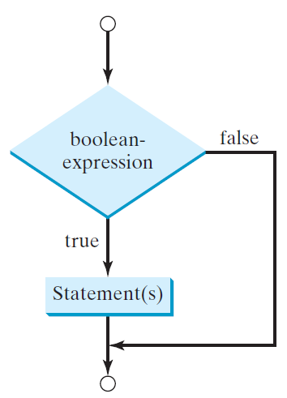
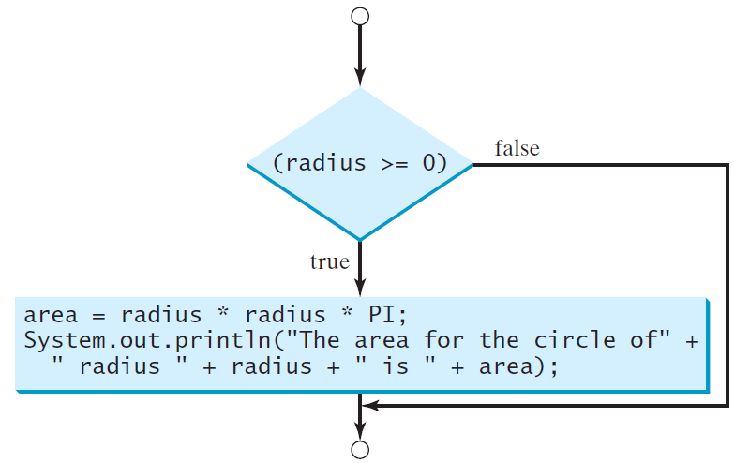
One-way if Statements
if (radius >= 0) {
area = radius * radius * PI;
System.out.println("The area"
+ " for the circle of radius "
+ radius + " is " + area);
}
if (boolean-expression) {
statement(s);
}

Slide 45
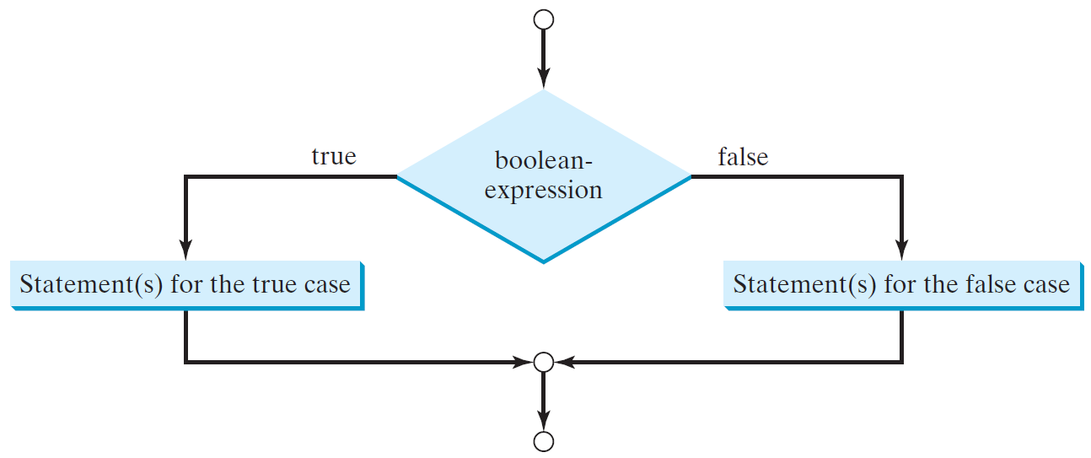
The Two-way if Statement
if (boolean-expression) {
statement(s)-for-the-true-case;
}
else {
statement(s)-for-the-false-case;
}

Slide 46
switch Statements
switch (status) {
case 0: compute taxes for single filers;
break;
case 1: compute taxes for married file jointly;
break;
case 2: compute taxes for married file separately;
break;
case 3: compute taxes for head of household;
break;
default: System.out.println("Errors: invalid status");
System.exit(1);
}

Slide 47
Conditional Expressions
if (x > 0)
y = 1
else
y = -1;
is equivalent to
y = (x > 0) ? 1 : -1;
(boolean-expression) ? expression1 : expression2
Ternary operator
Binary operator
Unary operator

Slide 48
Chapter 4
Mathematical Functions, Characters, and Strings

Slide 49
Calling Static Methods
A static method does not operate on an object
double x = 4;
double root = x.sqrt(); // Error
Static methods are declared inside classes
Naming convention: Classes start with an uppercase letter; objects start with a lowercase letter:
Math
System.out

Slide 50
The String Class
A string is a sequence of characters
Strings are objects of the String class
A string literal is a sequence of characters enclosed in double quotation marks:
"Hello, World!"
String length is the number of characters in the String
Example: "Harry".length() is 5
Empty string: ""

Slide 51
Concatenation
Use the + operator:
String name = "Dave";
String message = "Hello, " + name;
// message is "Hello, Dave"
If one of the arguments of the + operator is a string, the other is converted to a string
String a = "Agent”;
int n = 7;
String bond = a + n; // bond is "Agent7"

Slide 52
Converting between Strings and Numbers
Convert to number:
int n = Integer.parseInt(str);
double x = Double.parseDouble(x);
Convert to string:
String str = "" + n;
str = Integer.toString(n);

Slide 53

Substrings
String greeting = "Hello, World!";
String sub = greeting.substring(0, 5); // sub is "Hello"
Supply start and “past the end” position
First position is at 0

Slide 54
Reading Input From a Dialog Box
String input = JOptionPane.showInputDialog(prompt)
Convert strings to numbers if necessary:
int count = Integer.parseInt(input);
Conversion throws an exception if user doesn’t supply a number — see Chapter 11
Add System.exit(0) to the main method of any program that uses JOptionPane

Slide 55
Chapter 5
Loops
Notes:
Start

Slide 56
while Loops
A while statement executes a block of code repeatedly
A condition controls how often the loop is executed
while (condition)
statement
Most commonly, the statement is a block statement (set of statements delimited by { })

Slide 57
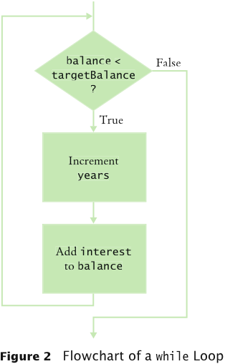
while Loop Flowchart

Slide 58
Common Error: Infinite Loops
Example:
int years = 0; while (years < 20)
{
double interest = balance * rate / 100;
balance = balance + interest;
}
Loop runs forever — must kill program

Slide 59
Common Error: Off-by-One Errors
Off-by-one error: a loop executes one too few, or one too many, times
Example:
int years = 0; while (balance < 2 * initialBalance) { years++; double interest = balance * rate / 100; balance = balance + interest;
} System.out.println("The investment reached the target after " + years + " years.");
Should years start at 0 or 1?
Should the test be < or <=?

Slide 60
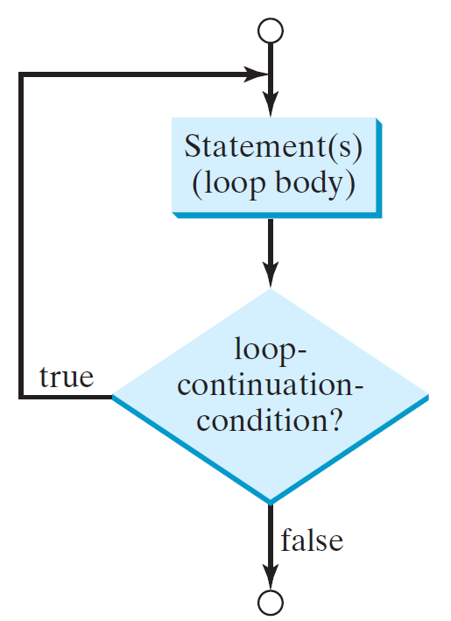
do-while Loop
do {
// Loop body;
Statement(s);
} while (loop-continuation-condition);

Slide 61
for Loops
Example:
for (int i = 1; i <= n; i++) { double interest = balance * rate / 100; balance = balance + interest; }
Use a for loop when a variable runs from a starting value to an ending value with a constant increment or decrement

Slide 62
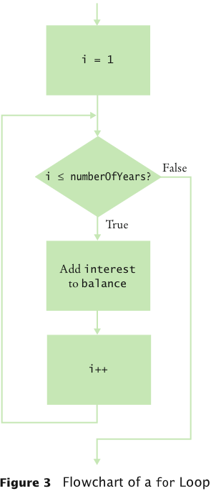
for Loop Flowchart

Slide 63
Using a Debugger
Debugger: a program to execute your program and analyze its run-time behavior
A debugger lets you stop and restart your program, see contents of variables, and step through it
The larger your programs, the harder to debug them simply by inserting print commands
Debuggers can be part of your IDE (e.g. Eclipse, BlueJ) or separate programs (e.g. JSwat)
Three key concepts:
Breakpoints
Single-stepping
Inspecting variables
Notes:
START

Slide 64
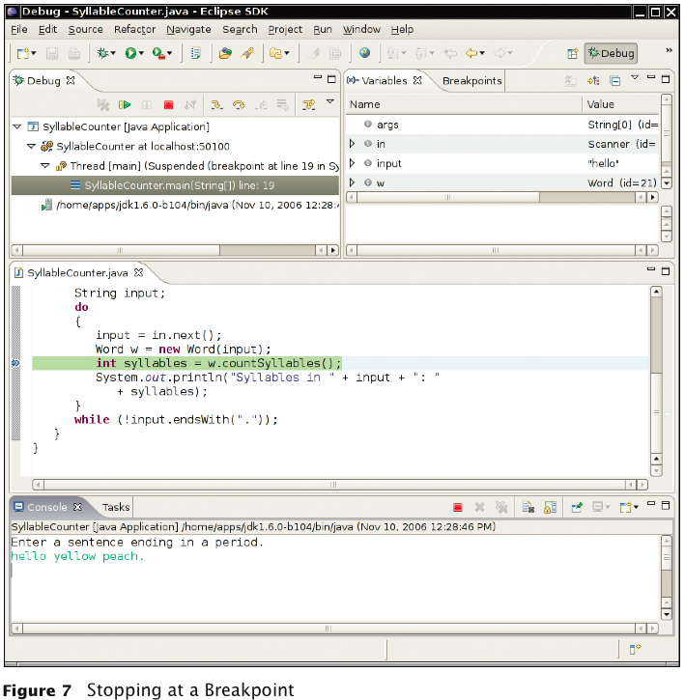
The Debugger Stopping at a Breakpoint

Slide 65
Debugging
Execution is suspended whenever a breakpoint is reached
In a debugger, a program runs at full speed until it reaches a breakpoint
When execution stops you can:
Inspect variables
Step through the program a line at a time
Or, continue running the program at full speed until it reaches the next breakpoint
When program terminates, debugger stops as well
Breakpoints stay active until you remove them
Two variations of single-step command:
Step Over: Skips method calls
Step Into: Steps inside method calls

Slide 66
Nested Loops
Problem: Write a program that uses nested for loops to print a multiplication table.

Slide 67
break

Slide 68
continue

Slide 69
Chapter 6
Methods

Slide 70
Why Write Methods?
Methods are commonly used to break a problem down into small manageable pieces. This is called divide and conquer.
Methods simplify programs. If a specific task is performed in several places in the program, a method can be written once to perform that task, and then be executed anytime it is needed. This is known as code reuse.

Slide 71
Two Parts of Method Declaration
Header
public static void displayMesssage()
{
System.out.println("Hello");
}
Body

Slide 72
Parts of a Method Header
Method Modifiers
Return Type
Method Name
Parentheses
public static void displayMessage ()
{
System.out.println("Hello");
}

Slide 73
Calling a Method
A method executes when it is called.
The main method is automatically called when a program starts, but other methods are executed by method call statements.
displayMessage();
Notice that the method modifiers and the void return type are not written in the method call statement. Those are only written in the method header.

Slide 74
Defining Methods
A method is a collection of statements that are grouped together to perform an operation.

Slide 75
Method Signature
Method signature is the combination of the method name and the parameter list.

Slide 76
Formal Parameters
The variables defined in the method header are known as formal parameters.

Slide 77
Actual Parameters
When a method is invoked, you pass a value to the parameter. This value is referred to as actual parameter or argument.

Slide 78
Return Value Type
A method may return a value. The returnValueType is the data type of the value the method returns. If the method does not return a value, the returnValueType is the keyword void. For example, the returnValueType in the main method is void.

Slide 79
Scope of Local Variables

Slide 80
Chapter 7
Arrays

Slide 81
Arrays
Array: Sequence of values of the same type
Construct array:
new double[10]
Store in variable of type double[]:
double[] data = new double[10];
When array is created, all values are initialized depending on array type:
Numbers: 0
Boolean: false
Object References: null

Slide 82
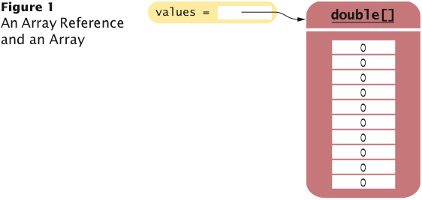
Arrays

Slide 83
Arrays
Using the value stored:
System.out.println("The value of this data item is "
+ values[2]);
Get array length as values.length (Not a method!)
Index values range from 0 to length - 1
Accessing a nonexistent element results in a bounds error:
double[] values = new double[10];
values[10] = 29.95; // ERROR
Limitation: Arrays have fixed length

Slide 84
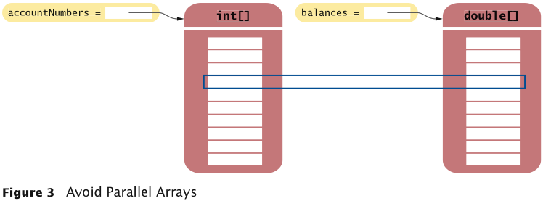
Make Parallel Arrays into Arrays of Objects
// Don't do this int[] accountNumbers; double[] balances;

Slide 85
Array Lists
ArrayList class manages a sequence of objects
Can grow and shrink as needed
ArrayList class supplies methods for many common tasks, such as inserting and removing elements
ArrayList is a generic class:
ArrayList<T>
collects objects of type parameter T:
ArrayList<String> names = new ArrayList<String>();
names.add("Emily");
names.add("Bob");
names.add("Cindy");
size method yields number of elements

Slide 86
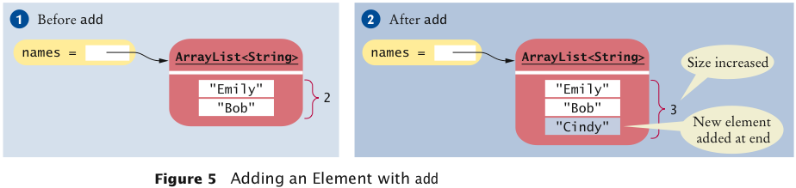
Adding Elements
To add an object to the end of the array list, use the add method:
names.add("Emily");
names.add("Bob");
names.add("Cindy");

Slide 87
Retrieving Array List Elements
To obtain the value an element at an index, use the get method
Index starts at 0
String name = names.get(2);
// gets the third element of the array list
Bounds error if index is out of range
Most common bounds error:
int i = names.size();
name = names.get(i); // Error
// legal index values are 0 ... i-1

Slide 88
Setting Elements
To set an element to a new value, use the set method:
names.set(2, "Carolyn");

Slide 89
Removing Elements
To remove an element at an index, use the remove method:
names.remove(1);

Slide 90
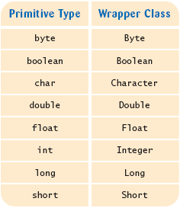
Wrappers
There are wrapper classes for all eight primitive types:

Slide 91
Auto-boxing
Auto-boxing: Automatic conversion between primitive types and the corresponding wrapper classes:
Double d = 29.95; // auto-boxing; same as
// Double d = new Double(29.95);
double x = d; // auto-unboxing; same as
// double x = d.doubleValue();
Auto-boxing even works inside arithmetic expressions:
d = d + 1;
Means:
auto-unbox d into a double
add 1
auto-box the result into a new Double
store a reference to the newly created wrapper object in d

Slide 92
The Enhanced for Loop
Traverses all elements of a collection:
double[] values = ...;
double sum = 0;
for (double element : values)
{
sum = sum + element;
}
Read the loop as “for each element in values”
Traditional alternative:
double[] values = ...;
double sum = 0;
for (int i = 0; i < values.length; i++)
{
double element = values[i];
sum = sum + element;
}

Slide 93
Partially Filled Arrays
Array length = maximum number of elements in array
Usually, array is partially filled
Need companion variable to keep track of current size
Uniform naming convention: final int VALUES_LENGTH = 100; double[] values = new double[VALUES_LENGTH]; int valuesSize = 0;
Update valuesSize as array is filled: values[valuesSize] = x; valuesSize++;

Slide 94
Chapter 9
Objects and Classes

Slide 95
OO Programming Concepts
Object-oriented programming (OOP)
Objects represent real world entities
Student
Bank Account
Object has a unique identity, state and behavior
State contained in properties, instance variables
Behavior provided by methods

Slide 96
Objects
An object has both a state and behavior. The state defines the object, and the behavior defines what the object does.

Slide 97
Classes
Classes define objects of the same type
A class is the blueprint
Classes use variables to hold state
Methods to provide behavior
Special method, Constructor, to create objects of this class

Slide 98
UML Class Diagram

Slide 99
Constructors
Constructors are a special kind of methods that are invoked to construct objects.
Circle()
{
}
Circle(double newRadius)
{
radius = newRadius;
}

Slide 100
Constructors, cont.
A constructor with no parameters is referred to as a no-arg constructor.
· Constructors must have the same name as the class itself.
· Constructors do not have a return type—not even void.
· Constructors are invoked using the new operator when an object is created. Constructors play the role of initializing objects.

Slide 101
Default Constructor
A class may be defined without constructors. In this case, a no-arg constructor with an empty body is implicitly defined in the class. This constructor, called a default constructor, is provided automatically only if no constructors are explicitly defined in the class.

Slide 102
Static Variables, Constants, and Methods
Static variables are shared by all the instances of the class. Static methods are not tied to a specific object.
Static constants are final variables shared by all the instances of the class.

Slide 103
Static Variables, Constants, and Methods, cont.
To declare static variables, constants, and methods, use the static modifier.

Slide 104
Visibility Modifiers and Accessor/Mutator Methods
By default, the class, variable, or method can be accessed by any class in the same package.
public
The class, data, or method is visible to any class in any package.
private
The data or methods can be accessed only by the declaring class.
The get and set methods are used to read and modify private properties.

Slide 105
The this Keyword
The this keyword is the name of a reference that refers to an object itself. One common use of the this keyword is reference a class’s hidden data fields.
Another common use of the this keyword to enable a constructor to invoke another constructor of the same class.

